Slide 1
Bit Pro UG
https://www.meetup.com/bangaloreitproug/

Slide 2

Generative AI using Azure OpenAI

Slide 3


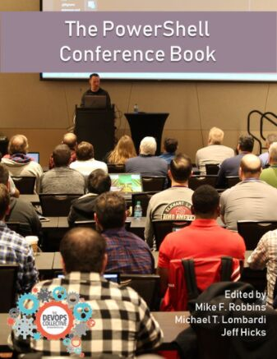
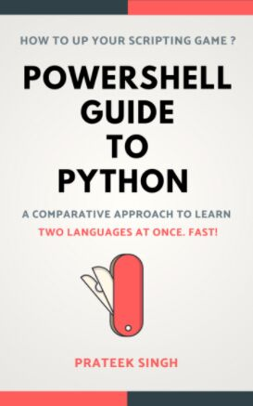



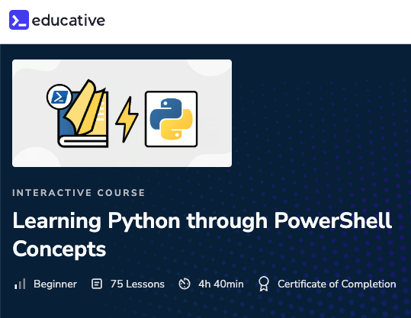






Hello
Introduction
BOOKS
PRATEEK SINGH
COURSE
TECH. WRITER FOR
Staff Software Engineer @ LinkedIn
/in/prateekkumarsingh
@singhprateik
/prateekkumarsingh
leanpub.com/b/books

Slide 4




Agenda
Agenda
1
2
3
4
Introduction
Concepts
Getting Started
Demo
Gentle Intro to Generative AI? And use cases.
Important terminologies and Concepts
Getting Started with Azure OpenAI Service
Simple Python Program to use OpenAI

Slide 5
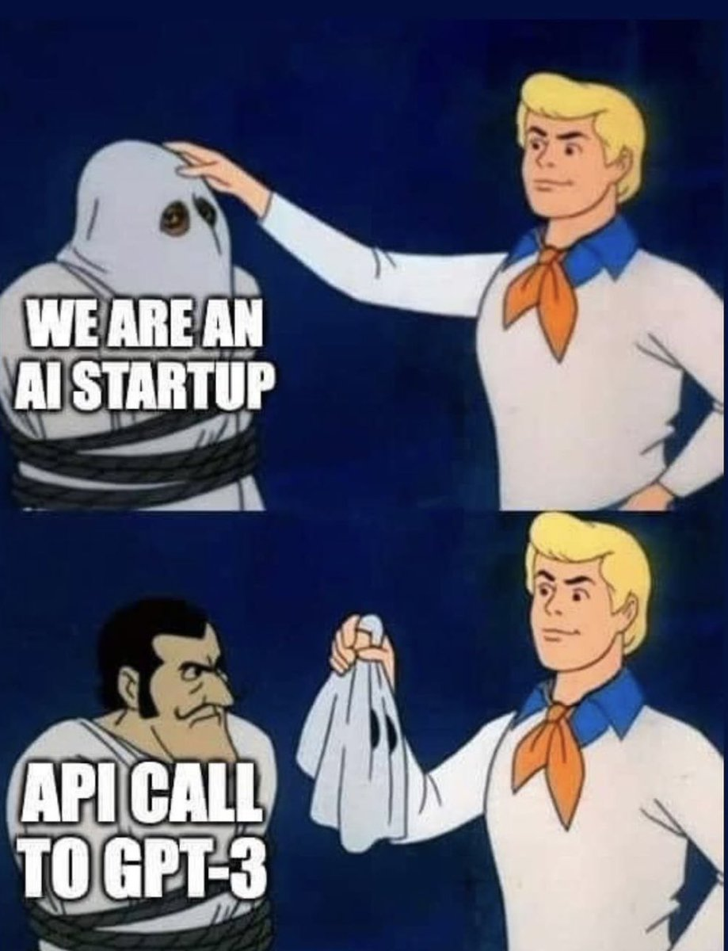
Gentle Intro to GenAI
Gentle Introduction to Generative AI

Slide 6
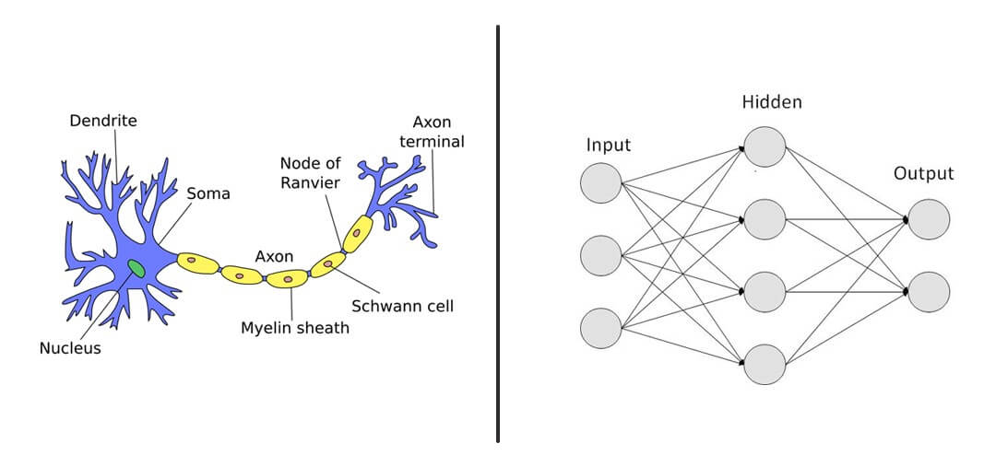

What is GenAI
What is Generative AI?
Generative + AI
Refers to the ability of the model to create new and original content. Based on a user-input and context also known prompt.
Artificial Intelligence

Slide 7
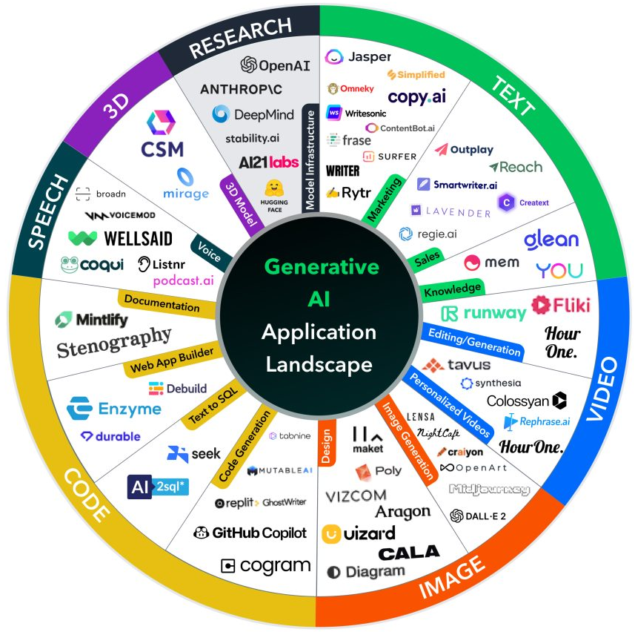
GenAI Tools
Generative AI Tools & use cases

Slide 8

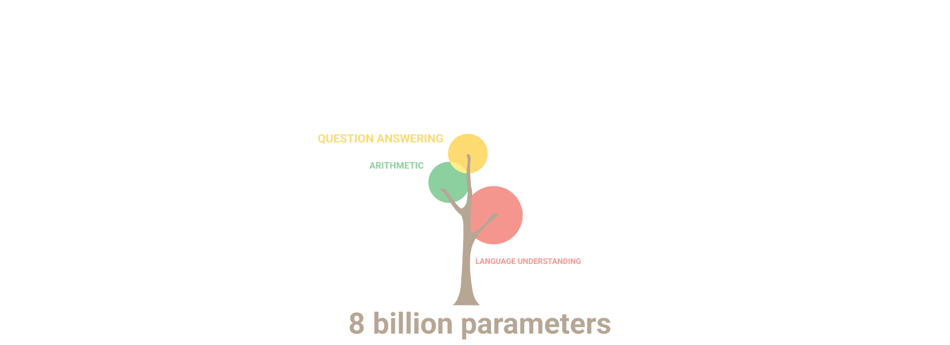
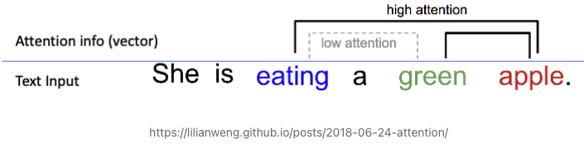
Concepts
Terminologies & Concepts
AI Models - Algorithms or computational representations in AI systems to simulate intelligence. Ex: ANN, CNN, NLP, GANs, Transformers etc.
Large Language Models (LLMs) - AI models that have been trained on massive amounts of text data to understand and generate human-like language, with a high level of accuracy and fluency.
AI Parameters - Internal variables that a model learns during training, representing the weights and biases of its neural network layers. LLaMA – 65B, GPT 3 - 135 B, PaLM – 540 B
Transformers – A deep learning model, that weigh the importance or relevance of different words or elements within a sequence when generating or understanding language.
GPT - Generative Pre-trained Transformers, a LLM developed by OpenAI Ex: GPT-2, GPT-3, BERT, PaLM, LLaMA GPT-3 etc.
Prompt Engineering - Crafting an optimized prompt to efficiently use LLMs and getting most value out of it.

Slide 9
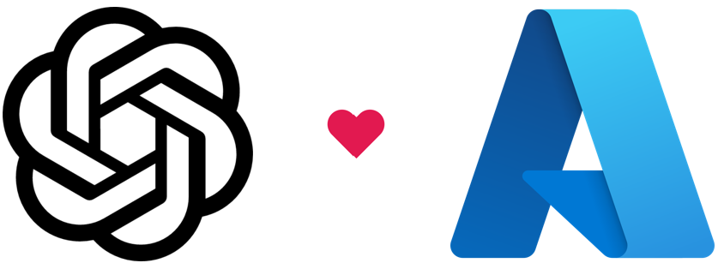
Azure OAI
Azure Open AI Service
But why Azure?
Advanced language AI with OpenAI
GPT-3
Codex,
and DALL-E models
Azure OpenAI co-develops the APIs with OpenAI, ensuring compatibility
Security and Enterprise promise of Azure.
Features Overview
Customizability – Fine-tuning base Models
Security – Private links and virtual networks
Managed Identities – via Azure Active Directory
UI Experience – via Azure OpenAI Service Studio
https://oai.azure.com/portal/
Content filtering - Adheres to content policy

Slide 10
Azure OAI continued
Azure Open AI Service
Prerequisites
An Azure subscription
Access granted to Azure OpenAI in the desired Azure subscription.
Submit a request here - aka.ms/oai/access
Models
Model Family | Description
GPT-4 (preview) | Drastic improvement on GPT-3.5
GPT-3 | A series of models that can understand and generate natural language.
Codex | A series of models that can understand and generate code, including translating natural language to code.
Embeddings | A set of models that can understand and use embeddings. An embedding is a special format of data representation that can be easily utilized by machine learning models and algorithms.
Open AI Studio in Azure
https://oai.azure.com/portal/

Slide 11
Thank you!
Get the slide deck and code samples on: https://github.com/prateekkumarsingh/presentations

